Slide 1
Logical Operations
Computer Architecture Lecture 5

Slide 2
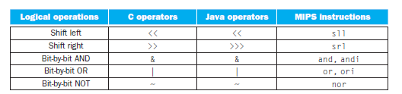
Introduction

Slide 3

Shifts
The first class of such operations is called shifts. They move all the bits in a word to the left or right, filling the emptied bits with 0s.
For example, if register $s0 contained
and the instruction to shift left by 4 was executed, the new value would be:

Slide 4

Shifts-Continue
The dual of a shift left is a shift right. The actual name of the two MIPS shift instructions are called shift left logical (sll) and shift right logical (srl).
sll $t2,$s0,4
Example
sll $t2,$s0,4
The machine language version of the instruction above is

Slide 5
Shifts-Continue
The encoding of sll is 0 in both the op and funct fields, rd contains 10 (register $t2), rt contains 16 (register $s0), and shamt contains 4. The rs field is unused and thus is set to 0.

Slide 6
Shifts-Continue
Shift left logical provides a bonus benefit. Shifting left by i bits gives the same result as multiplying by 2^{i}, just as shifting a decimal number by i digits is equivalent to multiplying by 10^{i}.
For example, the above sll shifts by 4, which gives the same result as multiplying by 2⁴ or 16.
The first bit pattern above represents 9, and 9 × 16 = 144, the value of the second bit pattern.
sll $t2,$s0,4

Slide 7


AND operation
AND is a bit-by‑bit operation that leaves a 1 in the result only if both bits of the operands are 1.
For example, if register $t2 contains
and register $t1 contains
then, after executing the MIPS instruction
and $t0,$t1,$t2
the value of register $t0 would be

Slide 8
AND operation-Continue
AND can apply a bit pattern to a set of bits to force 0s where there is a 0 in the bit pattern.
Such a bit pattern in conjunction with AND is traditionally called a mask, since the mask “conceals” some bits.

Slide 9
OR operation
It is a bit-by‑bit operation that places a 1 in the result if either operand bit is a 1.
For example, if register $t2 contains
and register $t1 contains
the result of the MIPS instruction
or $t0,$t1,$t2
is this value in register $t0:

Slide 10
Not Operation
NOT takes one operand and places a 1 in the result if one operand bit is a 0, and vice versa.
In keeping with the three-operand format, the designers of MIPS decided to include the instruction NOR (NOT OR) instead of NOT.
If one operand is zero, then it is equivalent to NOT: A NOR 0 = NOT (A OR 0) = NOT (A).

Slide 11
Not Operation
If the register $t1 is 0000 0000 0000 0000 0011 1100 0000 0000_{two} and register $t3 has the value 0, the result of the MIPS instruction
nor $t0,$t1,$t3
is this value in register $t0:
1111 1111 1111 1111 1100 0011 1111 1111two

Slide 12
Instructions for Making Decisions
MIPS assembly language includes two decision- making instructions, similar to an if statement with a go to. The first instruction is
beq register1, register2, L1
This instruction means go to the statement labeled L1 if the value in register1 equals the value in register2.
The mnemonic beq stands for branch if equal.

Slide 13
Instructions for Making Decisions-Cont.
bne register1, register2, L1
It means go to the statement labeled L1 if the value in register1 does not equal the value in register2.
The mnemonic bne stands for branch if not equal.
These two instructions are traditionally called conditional branches.

Slide 14
Example
In the following code segment, f, g, h, i, and j are variables. If the five variables f through j correspond to the five registers $s0 through $s4, what is the compiled MIPS code for this C if statement?
if (i == j) f = g + h; else f = g – h;
bne $s3,$s4,Else # go to Else if i ≠ j
add $s0,$s1,$s2 # f = g + h (skipped if i ≠ j)
j Exit # go to Exit
Else:sub $s0,$s1,$s2 # f = g – h (skipped if i = j)
Exit:

Slide 15
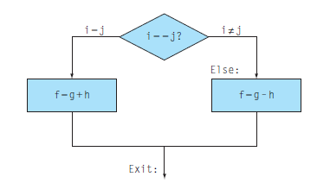
Example-Cont.
This example introduces another kind of branch, often called an unconditional branch.
This instruction says that the processor always follows the branch.
To distinguish between conditional and unconditional branches, the MIPS name for this type of instruction is jump, abbreviated as j.

Slide 16
Loops
Decisions are important both for choosing between two alternatives—found in if statements—and for iterating a computation—found in loops. The same assembly instructions are the building blocks for both cases.
Example
Here is a traditional loop in C:
while (save[i] == k)
i += 1;
Assume that i and k correspond to registers $s3 and $s5 and the base of the array save is in $s6. What is the MIPS assembly code corresponding to this C segment?

Slide 17
Loops
Here is a traditional loop in C:
while (save[i] == k)
i += 1;
Assume that i and k correspond to registers $s3 and $s5 and the base of the array save is in $s6. What is the MIPS assembly code corresponding to this C segment?
Loop: sll $t1,$s3,2 # Temp reg $t1 = i * 4
add $t1,$t1,$s6 # $t1 = address of save[i]
lw $t0,0($t1) # Temp reg $t0 = save[i]
bne $t0,$s5, Exit # go to Exit if save[i] ≠ k
addi $s3,$s3,1 # i = i + 1
j Loop # go to Loop
Exit:

Slide 18
set on less than Instruction
slt $t0, $s3, $s4 # $t0 = 1 if $s3 < $s4
means that register $t0 is set to 1 if the value in register $s3 is less than the value in register $s4; otherwise, register $t0 is set to 0.
Constant operands are popular in comparisons, so there is an immediate version of the set on less than instruction. To test if register $s2 is less than the constant 10, we can just write
slti $t0,$s2,10 # $t0 = 1 if $s2 < 10

Slide 19
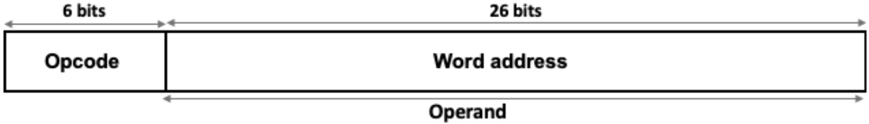
J-type Instruction
We have already implemented R-Type and I-Type instructions. Now, we will learn about J-type instruction
The only J-type instructions are the jump instructions j and jal
These instructions require a 26-bit coded address field to specify the target of the jump.

Slide 20
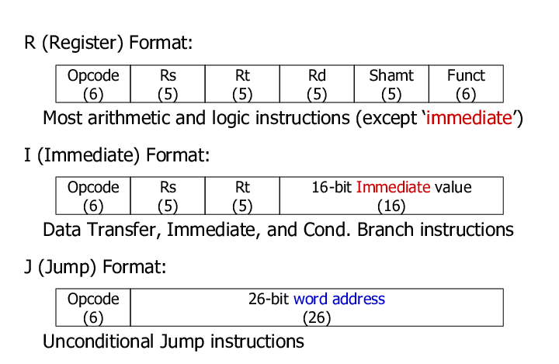
Instruction Format

Slide 21
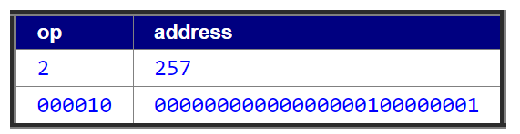
J-type Instruction
The address stored in a J instruction is 26 bits of the address associated with the specified label.
Example: J Loop
If Loop is at address 1028, then the value stored in the machine instruction would be 257(257= 1028/4).

Slide 22
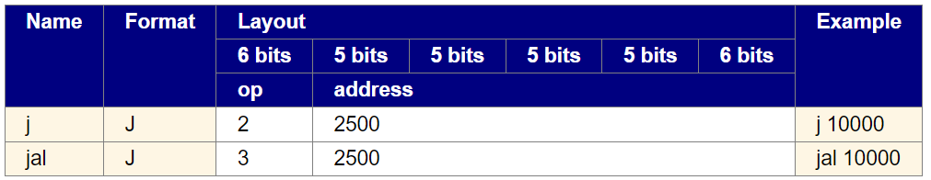
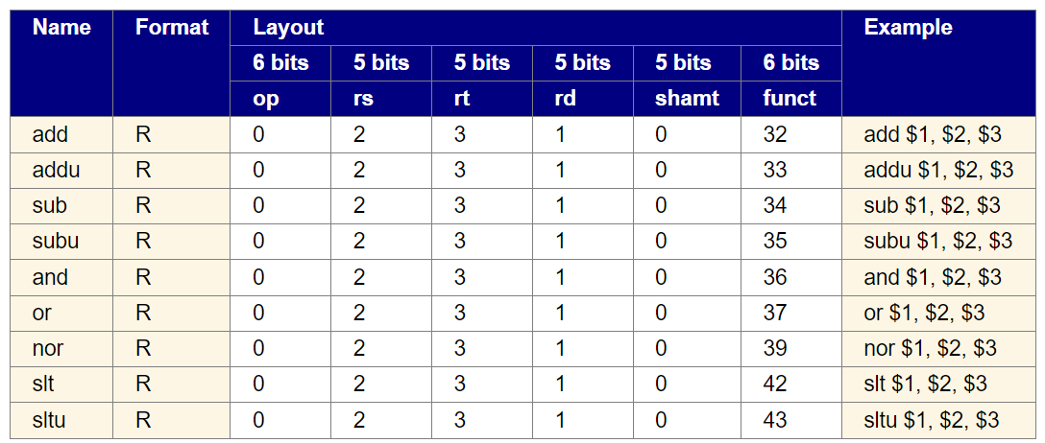
Instruction Format

Slide 23
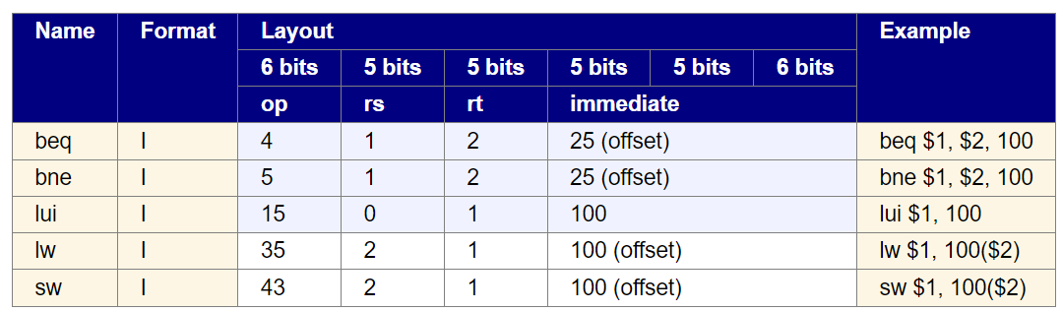
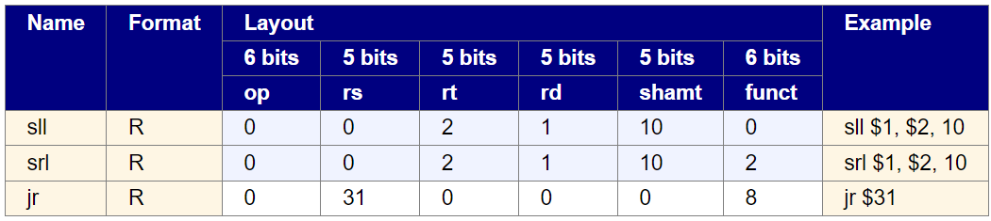
Instruction Format

Slide 24
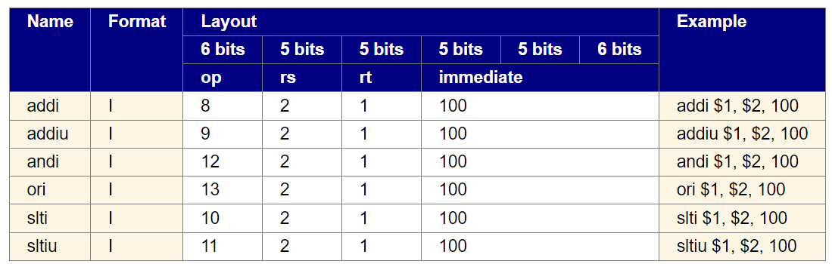
Instruction Format

